Slide 1
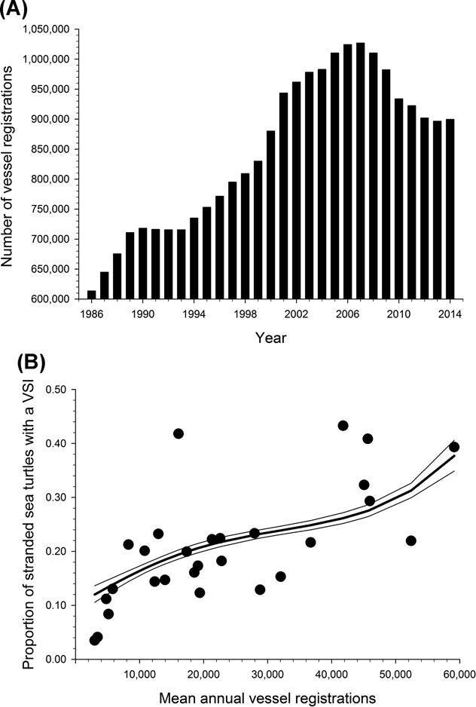
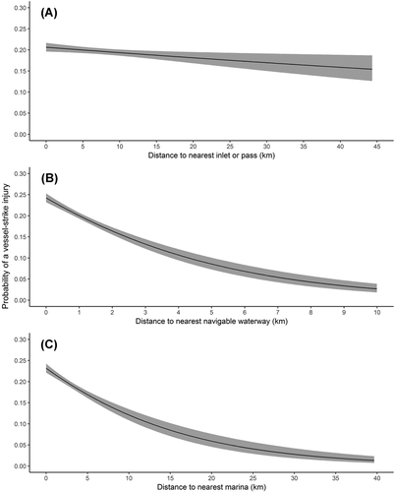
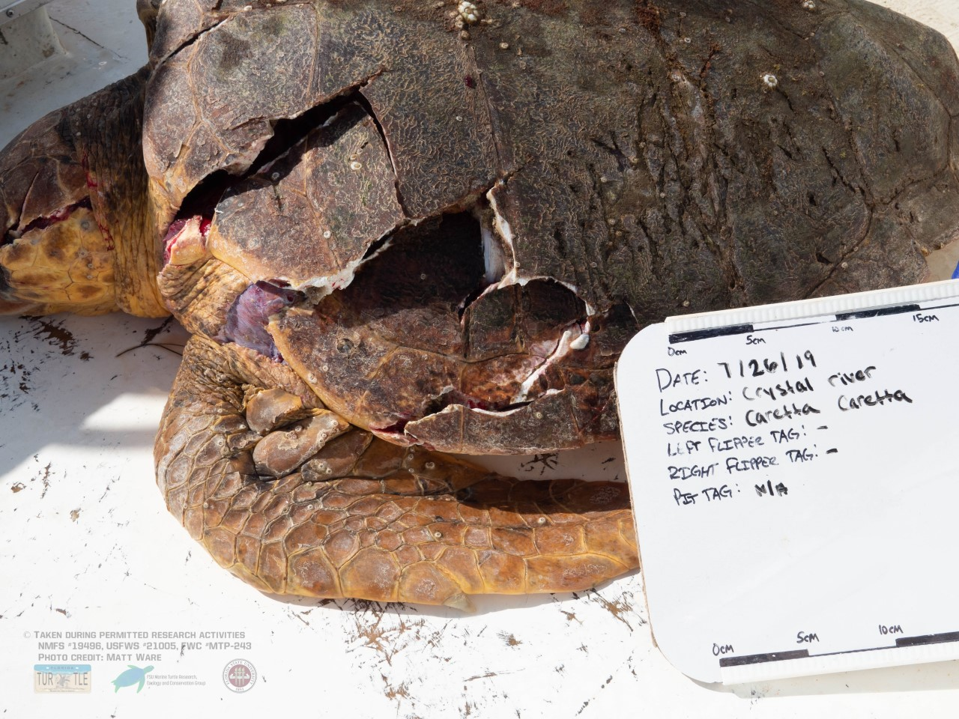
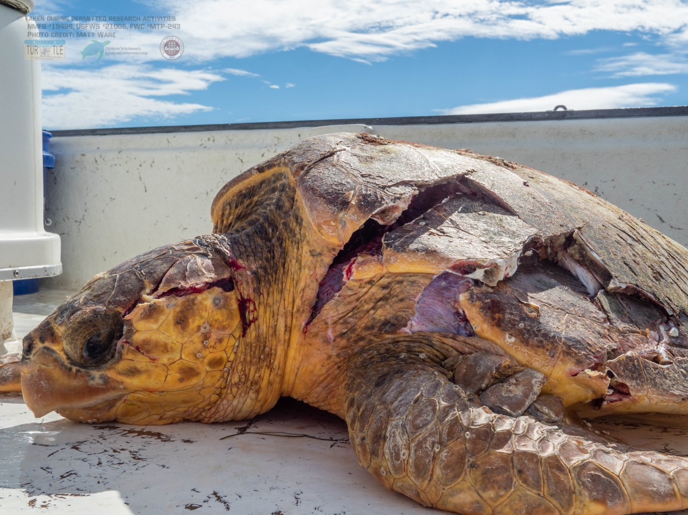
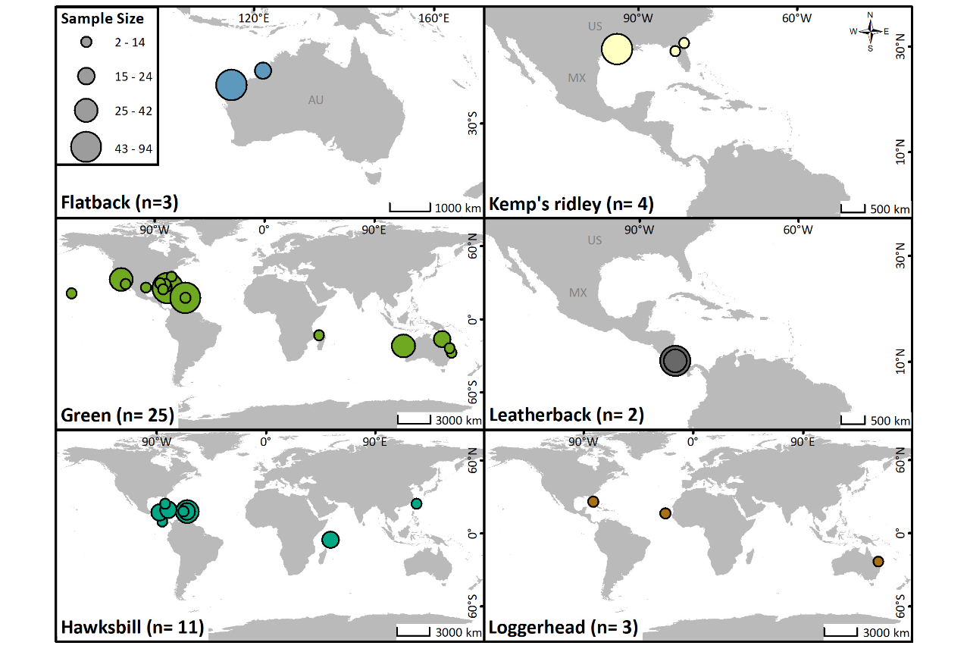
How Proper Data Collection and Delineation of Go-Slow Zones Can Lessen the Effects of Vessel Strikes on Marine Turtles
Gina Givens and Dr. Mariana Fuentes
Abstract
The average success rate of mandatory go-slow zones correlated with sea turtle migratory routes will provide necessary insight for improving the effectiveness of go-slow zones at preventing vessel strikes injuries (VSI) of marine sea turtles.
Introduction
Methodology
Results
Vessel strike injuries (VSI) are a leading cause of sea turtle strandings in FL
Go-slow zones are areas where boaters must adhere to a specific speed limit (i.e 25 MPH)
Effectiveness of go-slow zones for reducing VSI for marine turtles is largely unknown
A literature review was conducted to gather information related to FL boating, vessel strike injuries, and effectiveness of go-slow zones
Data was collected from different publications to identify what is needed to increase the effectiveness of go-slow zones
This information was then synthesized to identify data that is needed to design go-slow zones properly. These data include average boat speed in go-slow zones, number of vessel registrations in comparison to sea turtle strikes, as well as location where a majority of VSI's occur with the application of a go-slow zone
Collection of data regarding go-slow zones and their effectiveness is integral to lessen the number of VSI's on marine turtles
These data provide an insight of the consequences of ignoring the overlapping nature of marine turtle migratory routes and go-slow zones if not adhered properly
Conclusion
Satellite and acoustic telemetry are effective methods for identifying sea turtle spatial distribution
Future directions include assessment of compliance with go-slow zones and identification of ways to improve compliance
Hypothesis
We hypothesize that the establishment of go-slow zones in areas with high spatial and temporal overlap of vessel traffic and sea turtle habitat use will increase effectiveness and decrease the number of annual marine turtle VSIs and will require more data
Figure 1: Number of vessels registered in Florida, USA, each year, 1986–2014 and the proportion of stranded sea turtles (including loggerheads, green turtles, Kemp's ridleys, leatherbacks, and hawksbills) with a vessel-strike injury (VSI) in relation to the mean annual number of vessels registered by coastal county in Florida during 2000−2014
Credit: Foley et al. 2019
Figure 2: loggerheads, green turtles, Kemp's ridleys, leatherbacks, and hawksbills) exhibiting a definitive vessel-strike injury (VSI) and distance (km) to the nearest inlet or pass (A), to the nearest navigable waterway (B), and to the nearest marina (C) in Florida, USA, 1986–2014.
Credit: Foley et al. 2019
Sources: Foley, Allen M., et al. "Characterizing watercraft‐related mortality of sea turtles in Florida." The Journal of Wildlife Management 83.5 (2019): 1057-1072.
Hardin, Emily E., and Mariana MPB Fuentes. "A Systematic Review of Acoustic Telemetry as a Tool to Gain Insights Into Marine Turtle Ecology and Aid Their Conservation." Frontiers in Marine Science (2021).
Figure 3: Locations of acoustic telemetry studies for each species of marine turtle, with study sample sizes represented by the size of the marker
Credit: Hardin et al. 2021

